Slide 1
FOODIE APP
The Fastest Delivery
In Your City

Slide 2
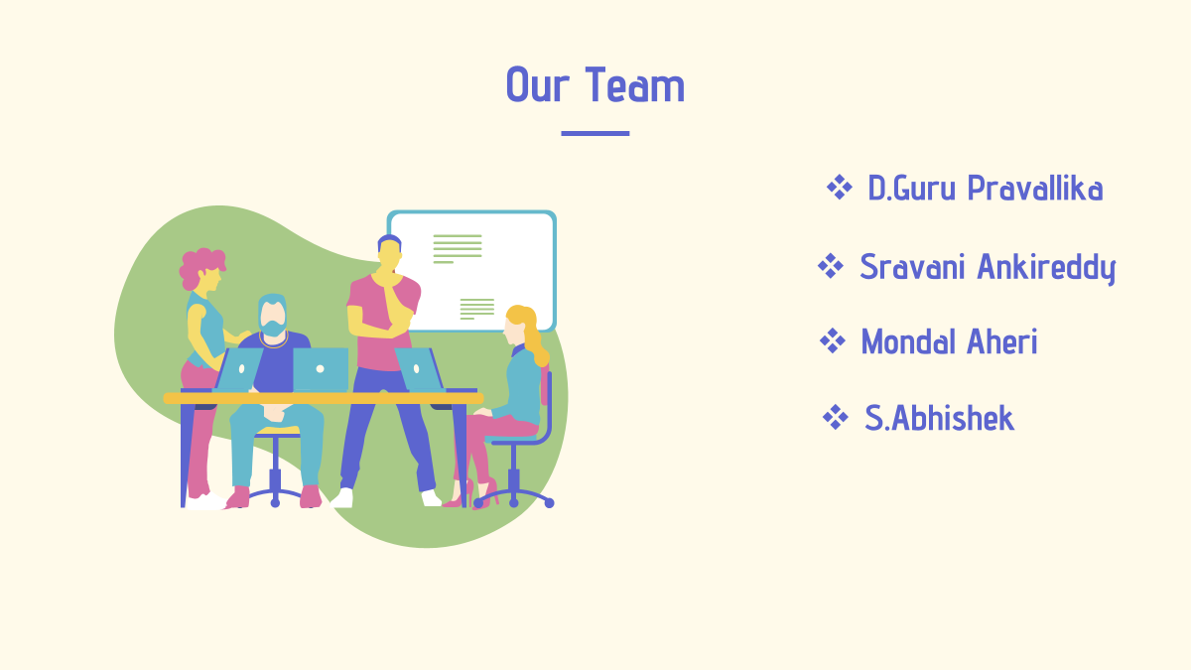

Slide 3
Introduction
It is the most convenient option available.
You can order food for any occasion, like; children's birthdays, student parties, company celebrations, weddings and even the daily food.
It helps people to save time, energy and fuel and they can order their favorite meal at any point of time.

Slide 4
TECHNOLOGIES USED
MongoDB
Express
React & Node.js

Slide 5
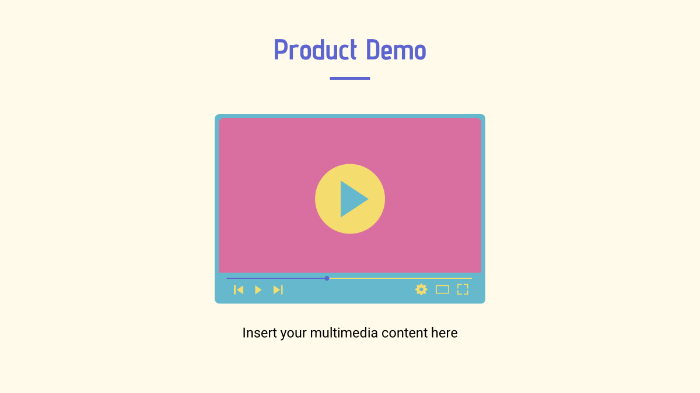

Slide 6
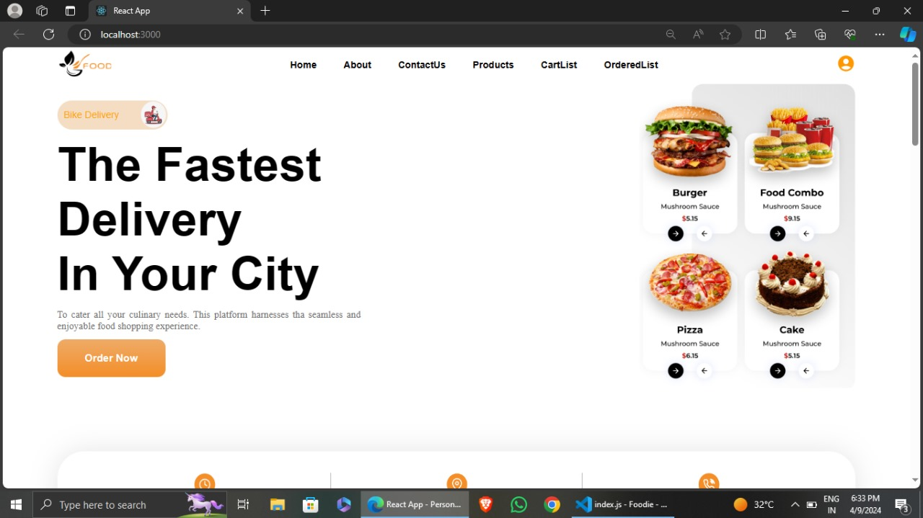
Working Of Project

Slide 7
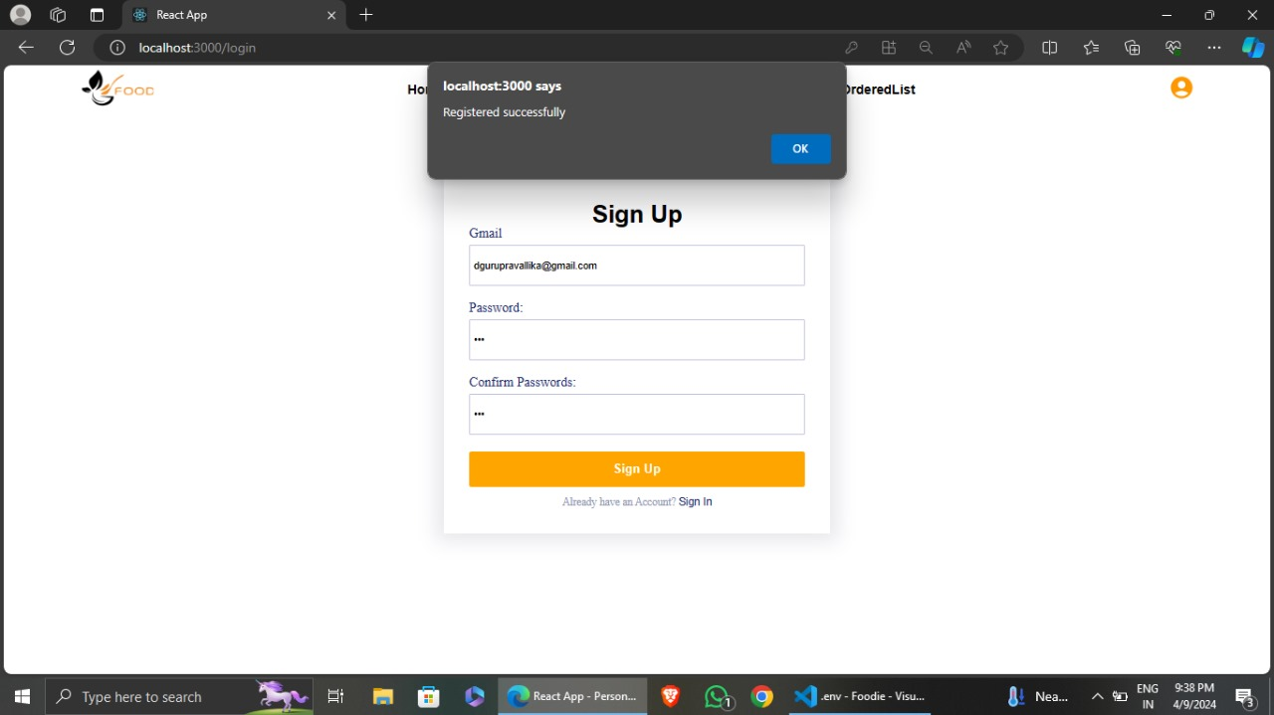

Slide 9
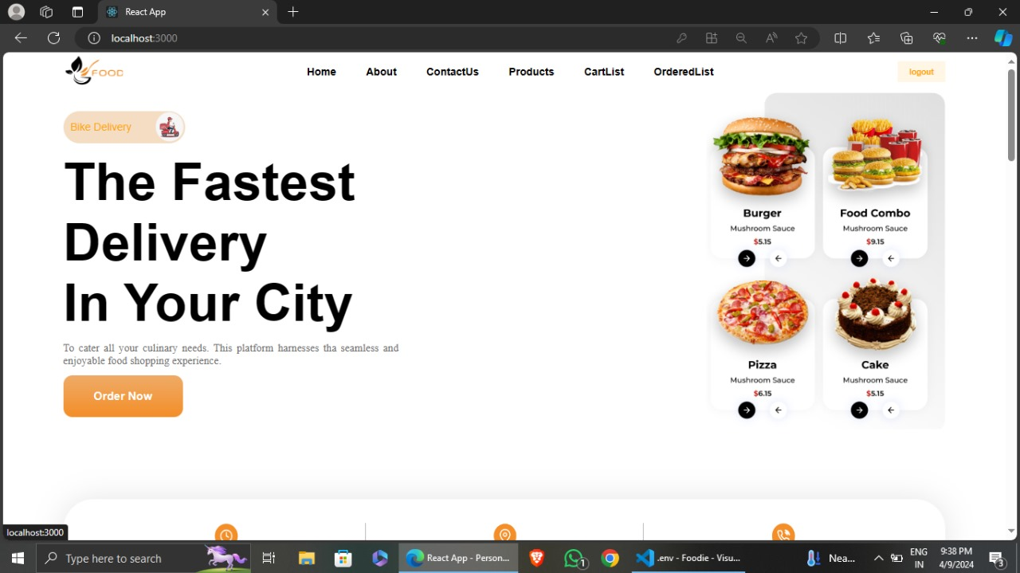

Slide 10
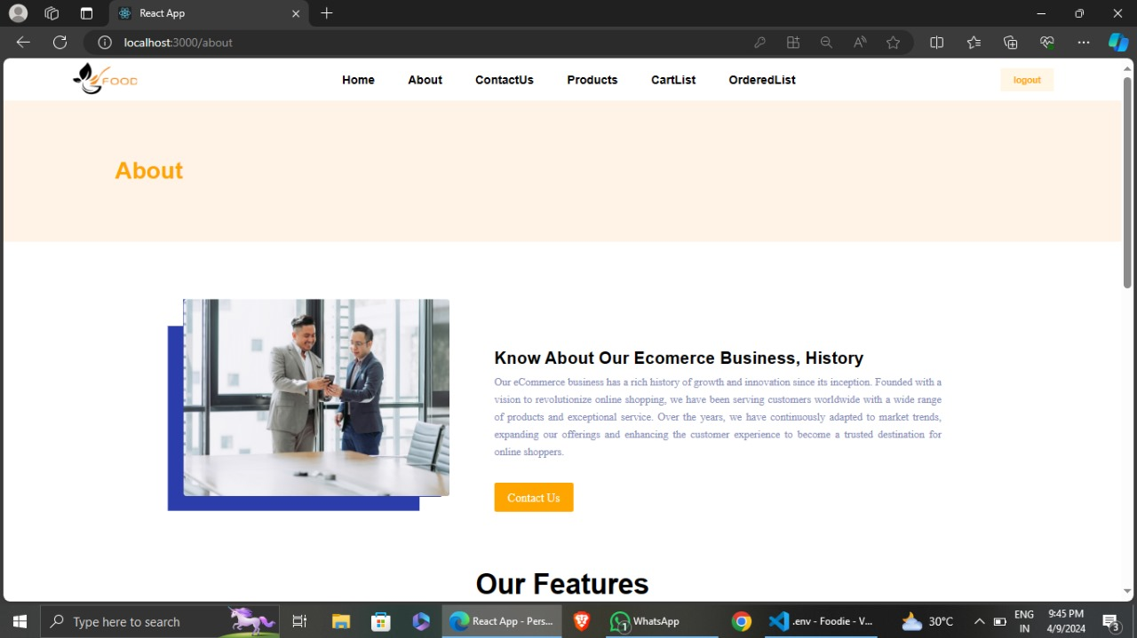

Slide 11
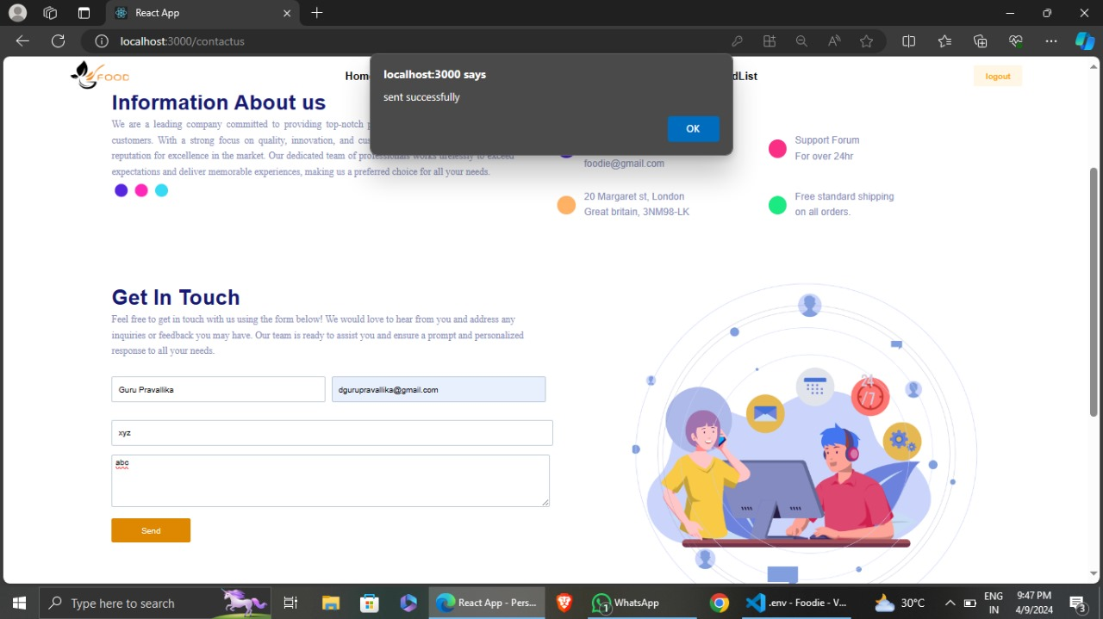

Slide 12
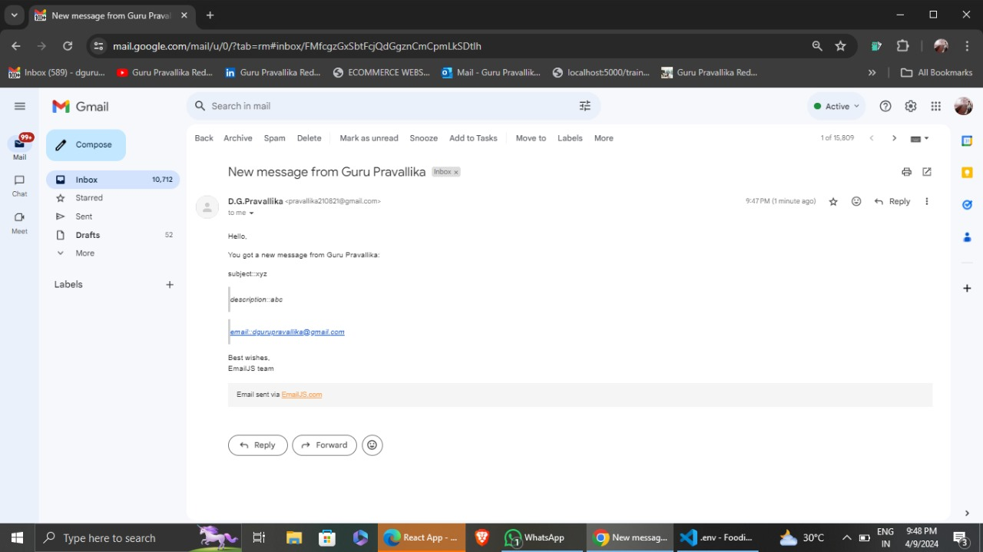

Slide 13
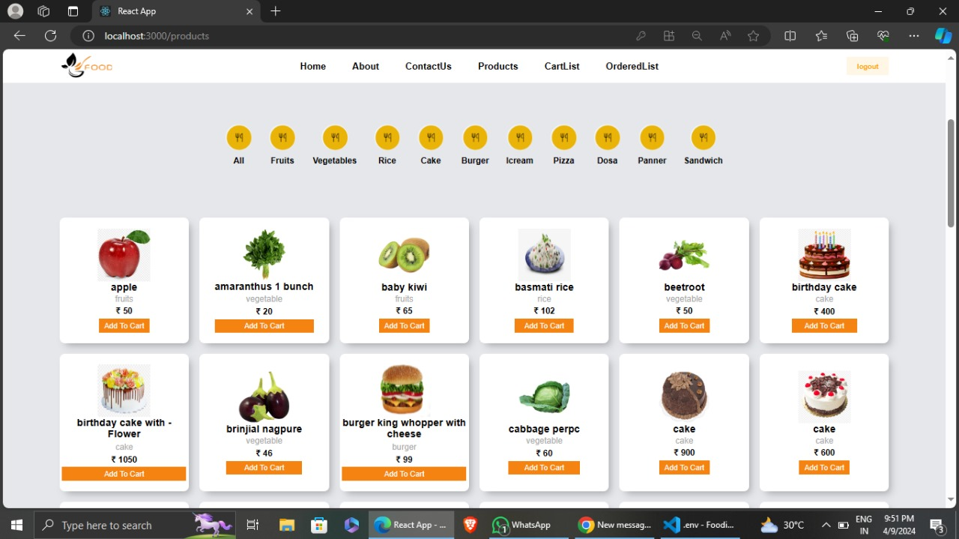

Slide 14
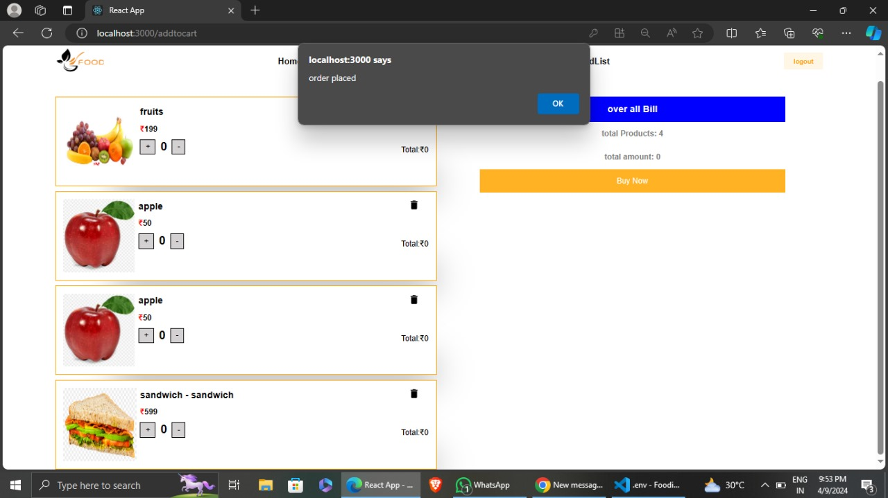

Slide 15
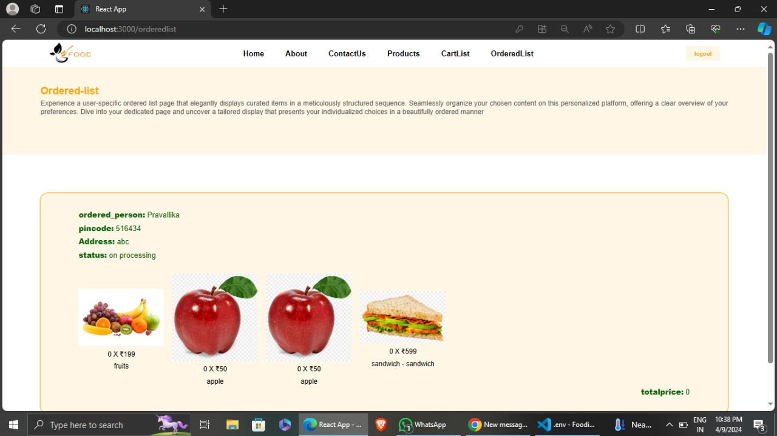

Slide 16
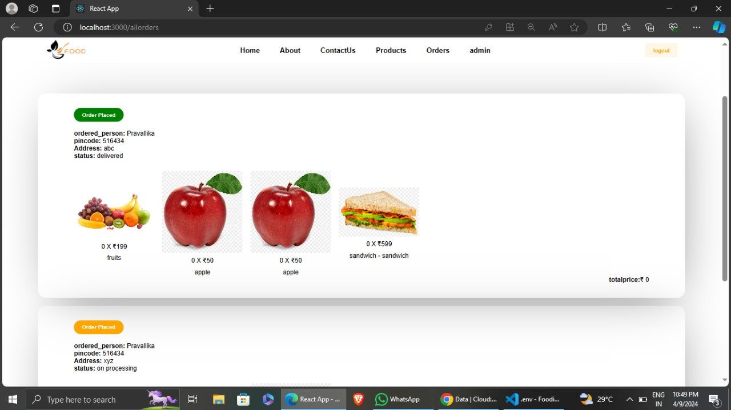

Slide 17
Thank You

